Slide 1

Internal and External Validity and Method of Control
December 13, 2011 , 2-3:30pm Drew MSRTP, Los Angeles, CA
Ron D. Hays, Ph.D. (drhays@ucla.edu)
- UCLA Department of Medicine: Division of General Internal Medicine and Health Services Research
- UCLA School of Public Health: Department of Health Services
- RAND, Santa Monica
http://gim.med.ucla.edu/FacultyPages/Hays/

Slide 2
Listed below are a few statements about your relationships with others. How much is each statement TRUE or FALSE for you?
I am always courteous even to people who are disagreeable.
There have been occasions when I took advantage of someone.
I sometimes try to get even rather than forgive and forget.
I sometimes feel resentful when I don’t get my way.
No matter who I’m talking to, I’m always a good listener.

Slide 3
Give yourself 1 point for each item that you answered as shown below
(Possible score range is 0-5)
I am always courteous even to people who are disagreeable. DEFINITELY TRUE
There have been occasions when I took advantage of someone. DEFINITELY FALSE
I sometimes try to get even rather than forgive and forget. DEFINITELY FALSE
I sometimes feel resentful when I don’t get my
way. DEFINITELY FALSE
No matter who I’m talking to, I’m always a good listener. DEFINITELY TRUE

Slide 4
How many people scored?
0 points? _______
1 point? _______
2 points? _______
3 points? _______
4 points? _______
5 points? _______
Mean was 1-2 points in MOS

Slide 5
Basic Concepts
Internal validity
  Data support conclusions about the hypothesis in the specific instance studied
External validity
  Findings of the study can be generalized to other populations and settings
Extraneous variable
  Capable of explaining the study findings without invoking the hypothesis (alternative explanation for the results)

Slide 6
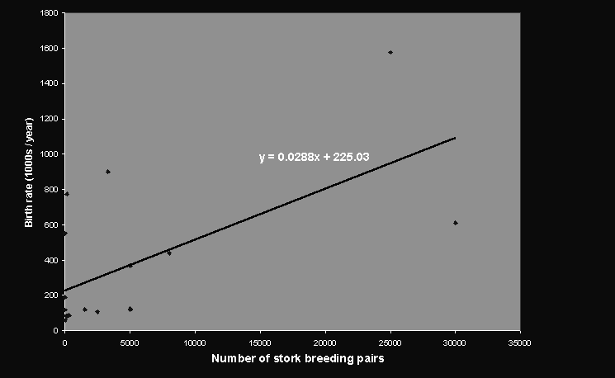
Correlation = 0.62 between number of breeding pairs of storks and births in 17 European Countries

Slide 7
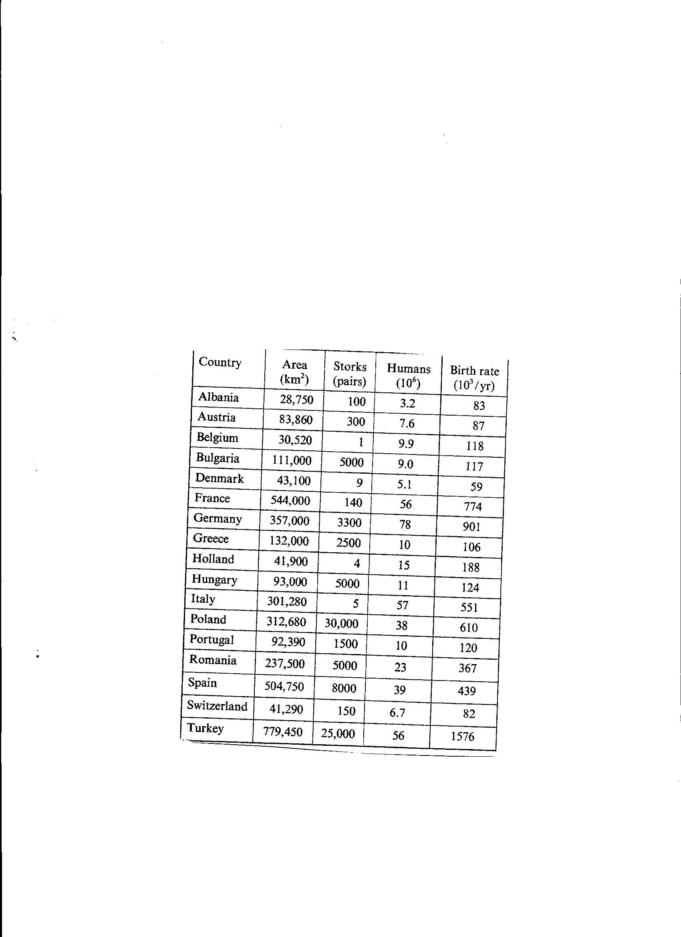

Slide 8
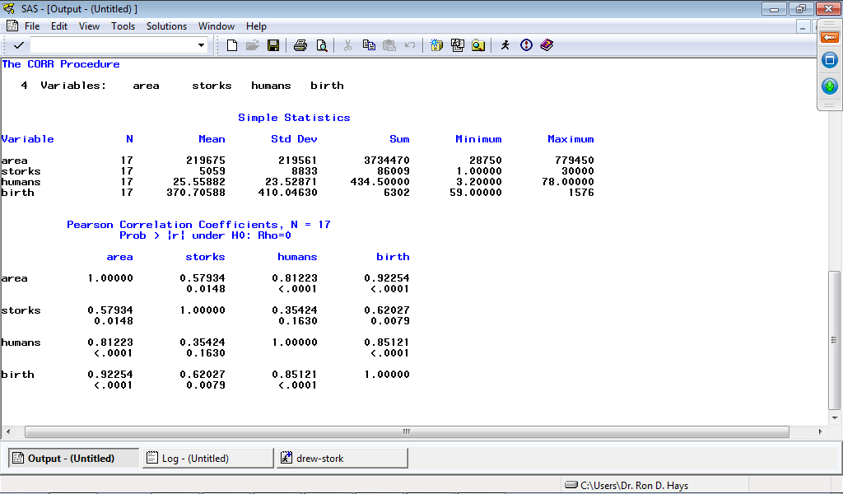

Slide 9
Do storks cause (increase the number of) births in Europe?
Birth
Rate
Storks
0.62

Slide 10
An extraneous variable, area
Area
Birth
Rate
0.92

Slide 11
Standardized regression coefficients show that storks do not cause births
Area
0.85
Birth
Rate
0.58
Storks
0.13

Slide 12
Factors that Compromise
Internal Validity
“On Stage” Effects
  Social desirability
  Evaluation apprehension
  Demand characteristics
  Looking bad
Hawthorne effects
Placebo effects
(Researcher/teacher) Expectancy effects
Personal relationship effects
Recall bias
Biased sample

Slide 13
“On Stage” Effects
Study participants may begin to “act” when they know they are being observed.
Social desirability
  Participant tells the observer what they think they “should” say.
Evaluation apprehension
  Participant tries to do what mentally health people are supposed to do
Demand characteristics
  Participant picks up by subtle clues about what the researcher wants the study to show and behaves so as to please the researcher.

Slide 14
“On Stage” Effects
Looking bad
  Participant tries to look bad to sabotage research or because it might lead to personal gain (e.g., student who wants to be able to take exam late claims to be sick)

Slide 15
Hawthorne Effects
Every time something was done to change the work routine, productivity increased initially but then went back to baseline.
Participants are aware they are being studied and given special treatment so they work harder.

Slide 16
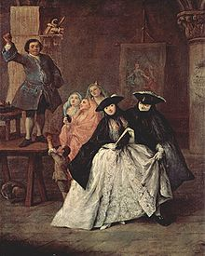
Placebo effects
Just expecting a treatment to work can lead to improvement
Power of suggestion by quacks and charlatans

Slide 17
Expectancy effects
If the researcher expects people to behave in a certain way, it may come to pass by the way she behaves toward them.
Pygmalion effect
  Teachers were told that some students were “late bloomers” (randomly) and those students had greater improvement in IQ scores than students not so labeled.

Slide 18

Personal relationship effects
The extent to which the researchers becomes known personally by the study participant may affect their behavior

Slide 19
Selective or distorted memory/recall bias
Study participant’s memory may be distorted to fit her opinion
Loss of memory for distant events
Telescoping

Slide 20
Biased sample
Coverage Error
Does each person in population have an equal chance of selection? (sample frame)
Sampling Error
Are only some members of the population sampled?
Nonresponse Error
Do people in the sample who respond differ from those who do not?
(Measurement Error--Are inaccurate answers given to survey questions?)

Slide 21
Methods of Control
Unobtrusive measures
Extended observation
Cross-checking
Deception
Masked (“blind”) measurement
Placebo and demand characteristics control groups
Controls for social desirability

Slide 22
Unobtrusive measures
Measure wear and tear on carpets in museum to determine popularity of different exhibits
Go through trash cans looking for discarded medicine bottles

Slide 23
Extended Observation and
Cross-Checking
Extended Observation
  Effects of being observed diminish over time
Cross-Checking
  Multiple observers
  Multiple time points

Slide 24
Deception
Purpose of study secret kept secret
In extreme, those observed are not told you are the researcher
Misinform participants deliberately in order to get more honest answers
  http://en.wikipedia.org/wiki/Milgram_experiment
  http://en.wikipedia.org/wiki/Stanford_prison_experiment
  http://en.wikipedia.org/wiki/Tuskegee_syphilis_experiment

Slide 25
Masked Measurement
Researcher doesn’t know which group the participant is randomized to be in
Participant doesn’t know either

Slide 26
Control Groups
Demand characteristics control
  Experimenter’s opinion about what is presented is shared
Placebo control

Slide 27
Controls for Social Desirability
Use of well-written survey questions
Forced choice between equally socially desirable options
Socially desirable response scale

Slide 28
Listed below are a few statements about your relationships with others. How much is each statement TRUE or FALSE for you?
I am always courteous even to people who are disagreeable.
There have been occasions when I took advantage of someone.
I sometimes try to get even rather than forgive and forget.
I sometimes feel resentful when I don’t get my way.
No matter who I’m talking to, I’m always a good listener.

Slide 29
Study Designs
Randomized experimental designs
Observational Study
  Quasi-experimental designs
    Matching
    Statistical control (e.g., propensity scores)

Slide 30
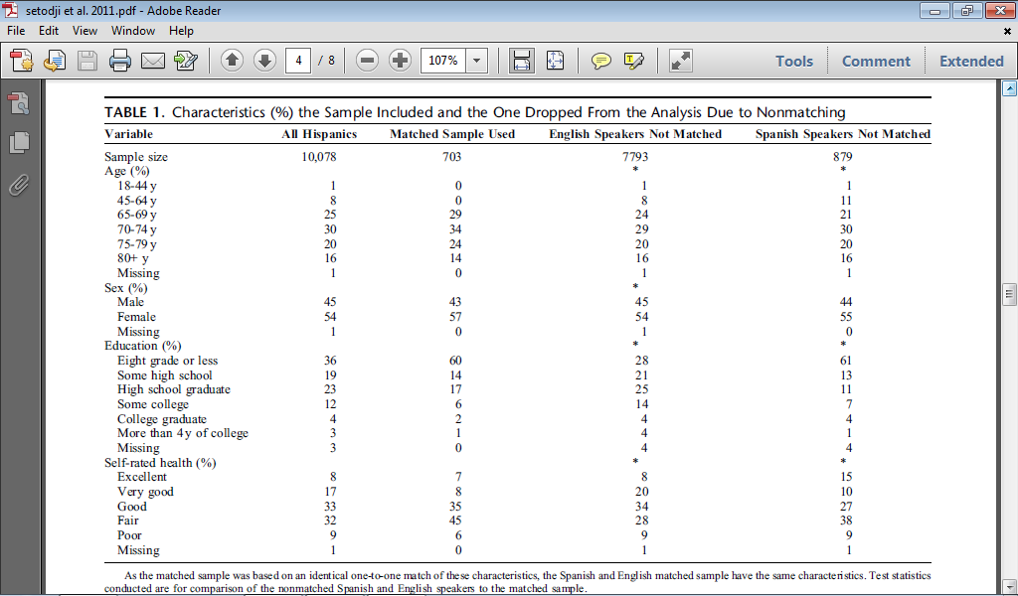

Slide 31

Thank you
Notes:
31

